Slide 1
Cuatro Llamadas de
Dios

Slide 2
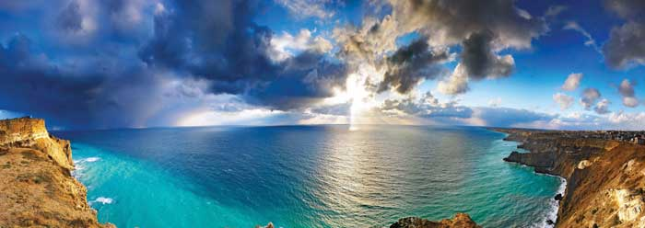
Llamada a cuidar con la creacion

Slide 3
Multiplica y llena la tiera
Gen 1:22
God blessed them and said, "Be fruitful and increase in number and fill the water in the seas, and let the birds increase on the earth."
NIV

Slide 4
Multiplica y llena la tierra
Isa 45:18 For this is what the Lord says — he who created the heavens,
he is God; he who fashioned and made the earth, he founded it;
he did not create it to be empty,
but formed it to be inhabited —
NIV

Slide 5
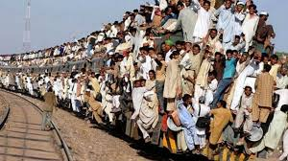
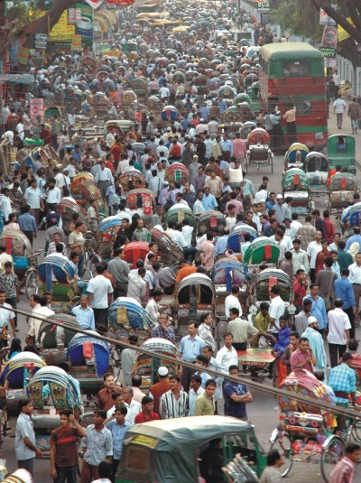
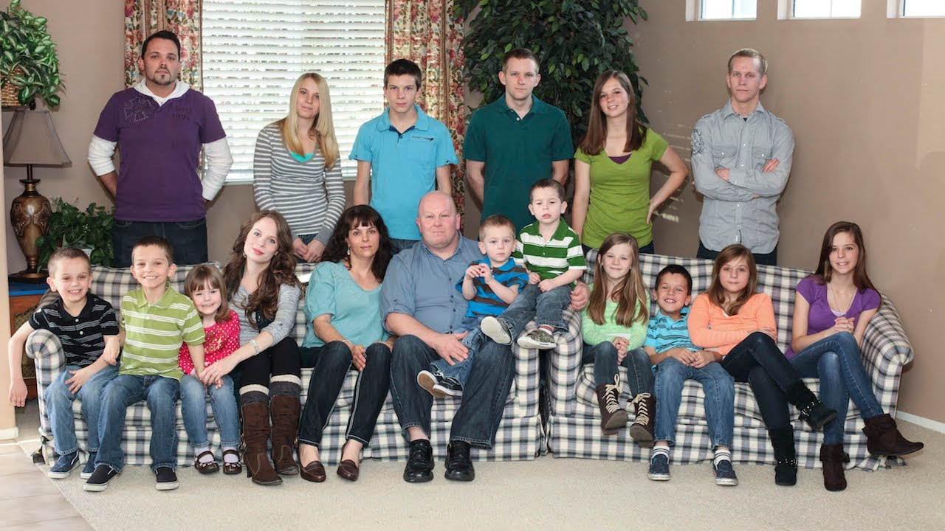
Multiplicar
y
Llenar

Slide 6
Subdue and Rule the Earth
Gen 1:21
"Be fruitful and increase in number; fill the earth and subdue it. Rule over the fish of the sea and the birds of the air and over every living creature that moves on the ground."
NIV

Slide 7
Subdue and Rule the Earth
Ps 8:6
you made him ruler over the works of your hands;
you put everything under his feet:
NIV

Slide 8
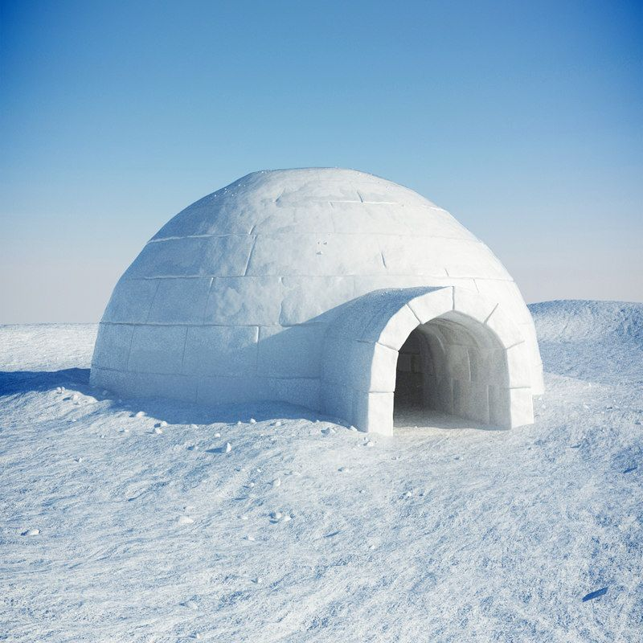
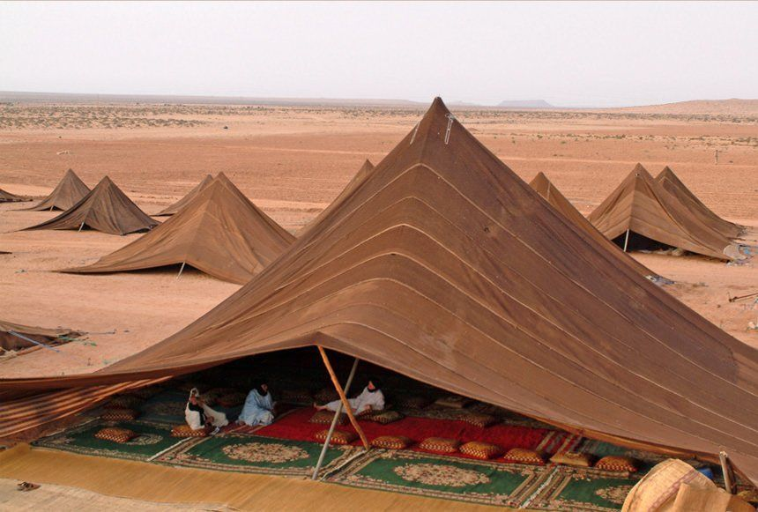
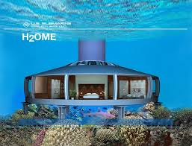
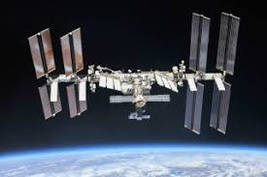
Subdue

Slide 9
BUT

Slide 10
We are not doing well
Ps 8:6
you made him ruler over the works of your hands;
you put everything under his feet:
NIV

Slide 11
We are not doing well
Isa 24:5-6
The earth is defiled by its people;
they have disobeyed the laws,
violated the statutes and broken the everlasting covenant. 6 Therefore a curse consumes the earth;
NIV

Slide 12
We are not doing well
Rom 8:20
We know that the whole creation has been groaning as in the pains of childbirth right up to the present time
NIV

Slide 13
Reflection
As a group discuss how you are doing as individuals and a group at fulfilling the call of God to fill the earth and subdue it.
How do your actions in relation to the earth affect your testimony to others?

Slide 14
Reflection
Pause
the Video

Slide 15
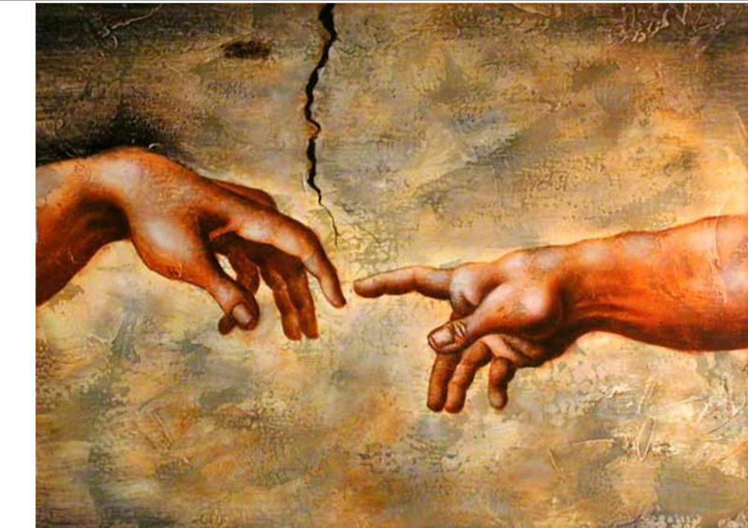
Call
to
Know
God

Slide 16
Possibility
Adam and eve – walked with God
Enoch – walked with God
Noah – spoke with God
Abraham – hosted God in his tent
Moses – spoke face to face with God
Isaiah – Saw God on his throne
John – saw God on his throne
Many others knew God
Thousands met Jesus then and still

Slide 17
The call to know
Ps 34:8
Taste and see that the Lord is good;
NIV

Slide 18
The call to know
Ps 46:10
"Be still, and know that I am God; I will be exalted among the nations, I will be exalted in the earth." NIV

Slide 19
The call to know
Ps 100:3
Know that the Lord is God.
It is he who made us, and we are his; we are his people, the sheep of his pasture. NIV

Slide 20
The call to know
Ps 9:10
Ps 22:6
Ps 24:6
Ps 27:7
Ps 27:8
Ps 40:16
Sp 63:1
Ps 70:4
Ps 105:3
Ps 119:10
Isa 55:6
Seek the Lord while he may be found; call on him while he is near.
NIV

Slide 21
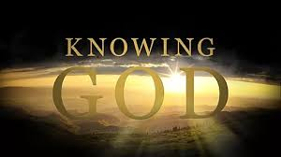
The call to know

Slide 22
No Excuse
Hab 2:14
for the earth will be filled with the knowledge of the glory of the Lord, as the waters cover the sea NIV

Slide 23
No Excuse
Eccl 3:11-12
He has also set eternity in the hearts of men; yet they cannot fathom what God has done from beginning to end. NIV

Slide 24
No Excuse
Ps 19:1-4 The heavens declare the glory of God;
the skies proclaim the work of his hands. Day after day they pour forth speech; night after night they display knowledge. There is no speech or language
where their voice is not heard. Their voice goes out into all the earth, their words to the ends of the world. NIV

Slide 25
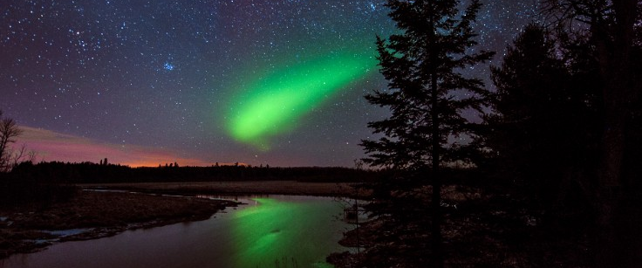
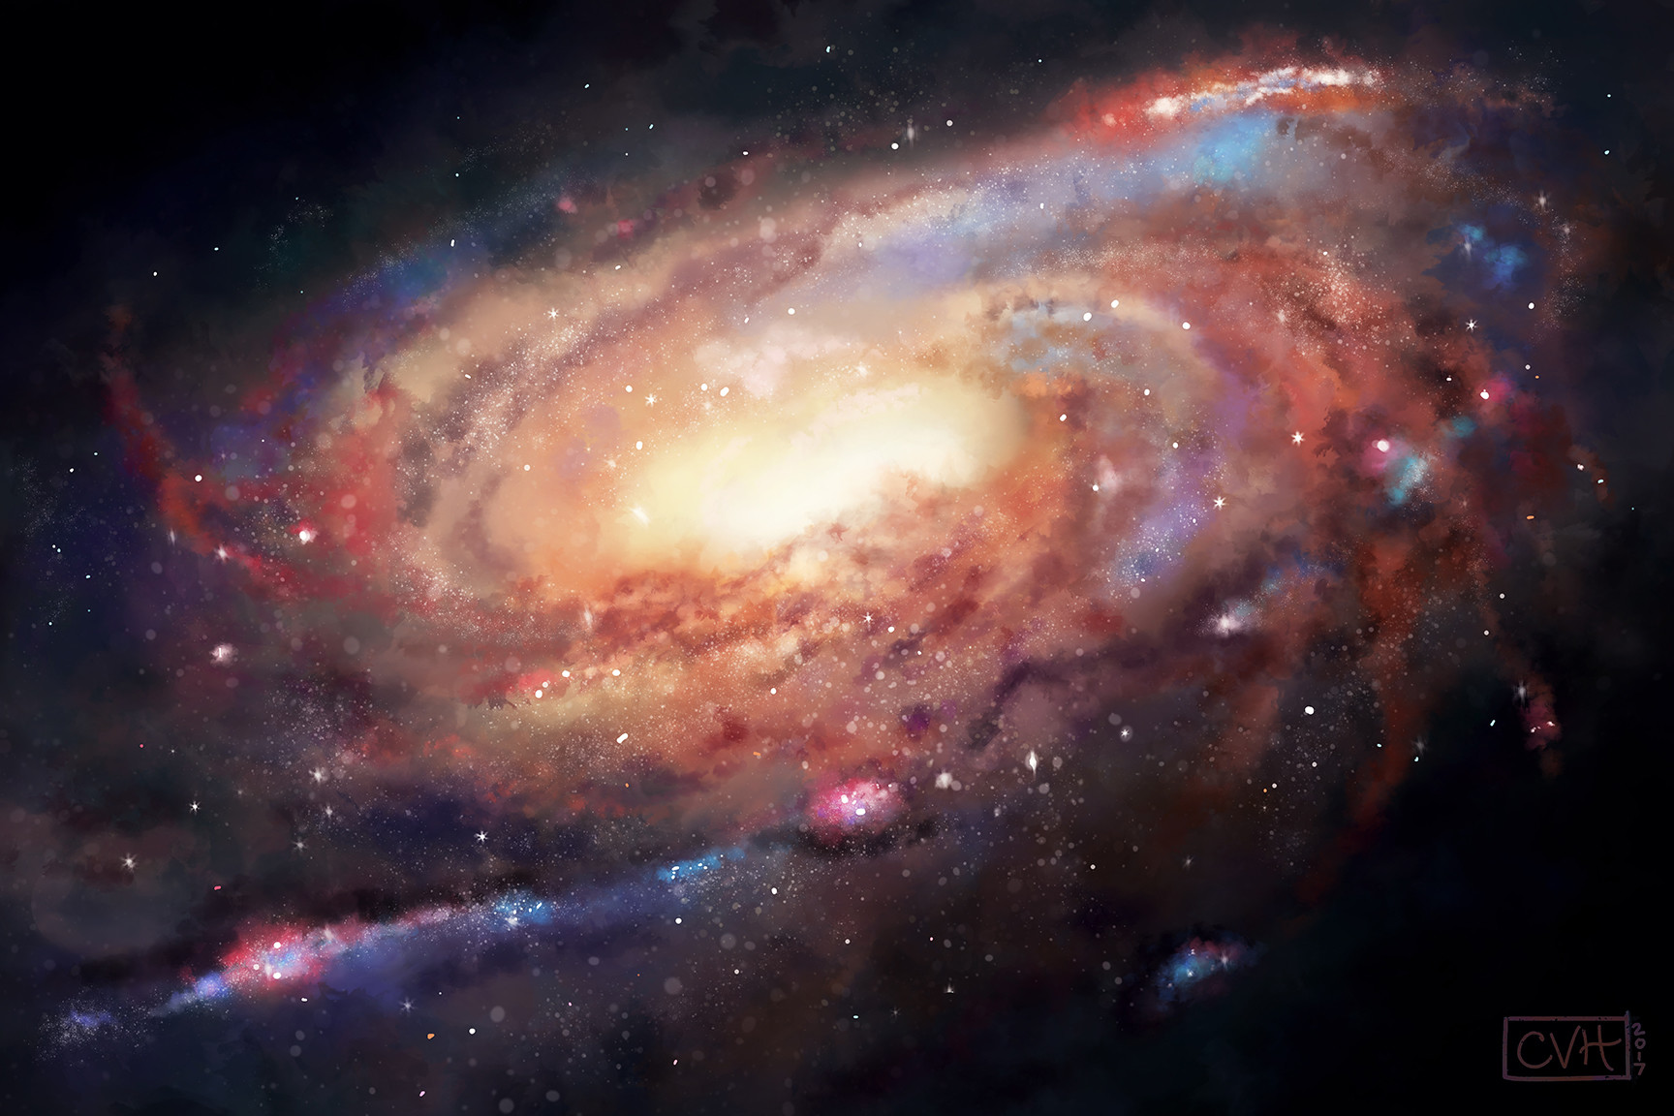
No Excuse

Slide 26
The Promise
2 Cor 4:6
For God, who said, "Let light shine out of darkness," made his light shine in our hearts to give us the light of the knowledge of the glory of God in the face of Christ. NIV

Slide 27
The Promise
Ps 98:2
the Lord has made his salvation known and revealed his righteousness to the nations.
NIV

Slide 28
Reflexion
Think about the first four commandments
No other God
No idols
Honor his name
Honor his activity - rest

Slide 29
Reflection

Slide 30
Reflection
How are you doing in knowing God?
How is your knowledge of God helping others to know God?

Slide 31
Reflection
Pause
the Video

Slide 32
Call to Salvation

Slide 33
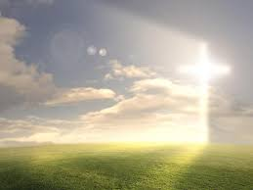
The Call is
To repentance
To reconciliation
To restauration
To renovation

Slide 34
To repentance
Matt 4:17 From that time on Jesus began to preach, "Repent, for the kingdom of heaven is near."
NIV

Slide 35
Lk 5:32
Ac 5:11
Ac 20:21
2 P2 3:9
To repentance
Acts 2:38 Peter replied, "Repent and be baptized, every one of you, in the name of Jesus Christ for the forgiveness of your sins. And you will receive the gift of the Holy Spirit NIV

Slide 36
Lk 5:32
Ac 5:11
Ac 20:21
2 P2 3:9
To repentance
Acts 2:38 Peter replied, "Repent and be baptized, every one of you, in the name of Jesus Christ for the forgiveness of your sins. And you will receive the gift of the Holy Spirit NIV

Slide 37
To reconciliation
Eph 2:15-16 His purpose was to create in himself one new man out of the two, thus making peace, and in this one body to reconcile both of them to God through the cross, by which he put to death their hostility.

Slide 38
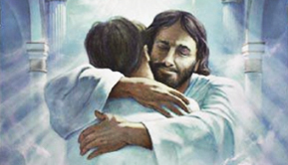
To reconciliation
Ro 5:11
2 Co 5:18-19
Co 1:22
Col 1:19-20 For God was pleased to have all his fullness dwell in him, and through him to reconcile to himself all things, whether things on earth or things in heaven, by making peace through his blood, shed on the cross.

Slide 39
To restauration
1 Peter 5:10-11
And the God of all grace, who called you to his eternal glory in Christ, after you have suffered a little while, will himself restore you and make you strong, firm and steadfast.
NIV

Slide 40
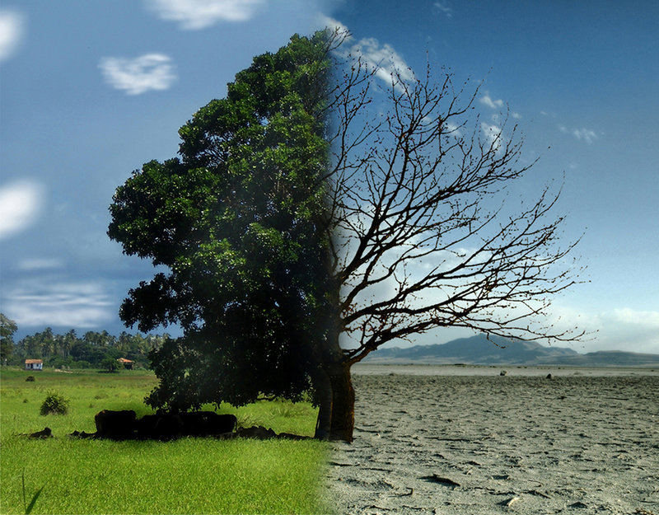
To restauration
Jn 11:52
Ro 8:14-17
Ro 8:23
2 Co 6:18
Ga 4:5-6
He 12:5-9
John 1:12
Yet to all who received him, to those who believed in his name, he gave the right to become children of God—
NIV

Slide 41
To renovation
Jn 11:52
Ro 8:14-17
Ro 8:23
2 Co 6:18
Ga 4:5-6
Ti 2:5
He 12:5-9
2Cor 5:17
Therefore, if anyone is in Christ, he is a new creation; the old has gone, the new has come
NIV

Slide 42
To renovation
2 Co 4:16
Ep 4:22-24
Co 3:10
Rom 12:2
Do not conform any longer to the pattern of this world, but be transformed by the renewing of your mind.
NIV

Slide 43
God’s Desire
2 Co 4:16
Ep 4:22-24
Co 3:10
2 Peter 3:9
He is patient with you, not wanting anyone to perish, but everyone to come to repentance.
NIV

Slide 44
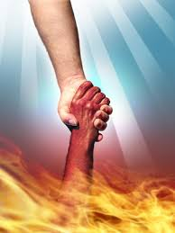
God’s Desire
1 Tim 2:3-4 This is good, and pleases God our Savior, 4 who wants all men to be saved and to come to a knowledge of the truth.
Jn 3:15-17
2 Co 5:17-19

Slide 45
Jn 3:15-17
2 Co 5:17-19
Reflection
What has been God’s plan from the beginning of Creation?
How do you know this?
Who do you believe should hear about this plan?

Slide 46
Jn 3:15-17
2 Co 5:17-19
Reflection
Pause
the Video

Slide 47
Call to Mission

Slide 48
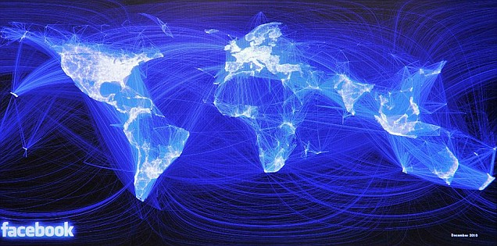
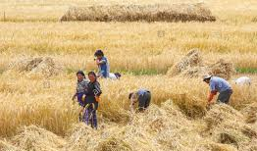
The Call
Matt 9:37-38 "The harvest is plentiful but the workers are few. Ask the Lord of the harvest, therefore, to send out workers into his harvest field."
NIV

Slide 49
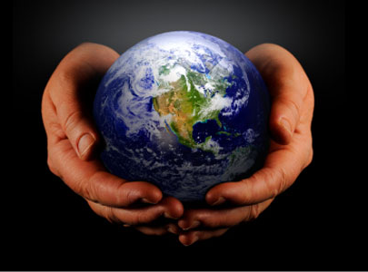
The Call Part one
Mark 16:15-16
"Go into all the world and preach the good news to all creation.

Slide 50
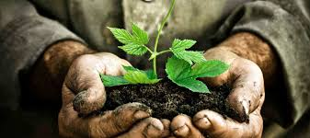
The Call – Part two
Matt 28:18
Therefore go and make disciples of all nations,
NIV

Slide 51
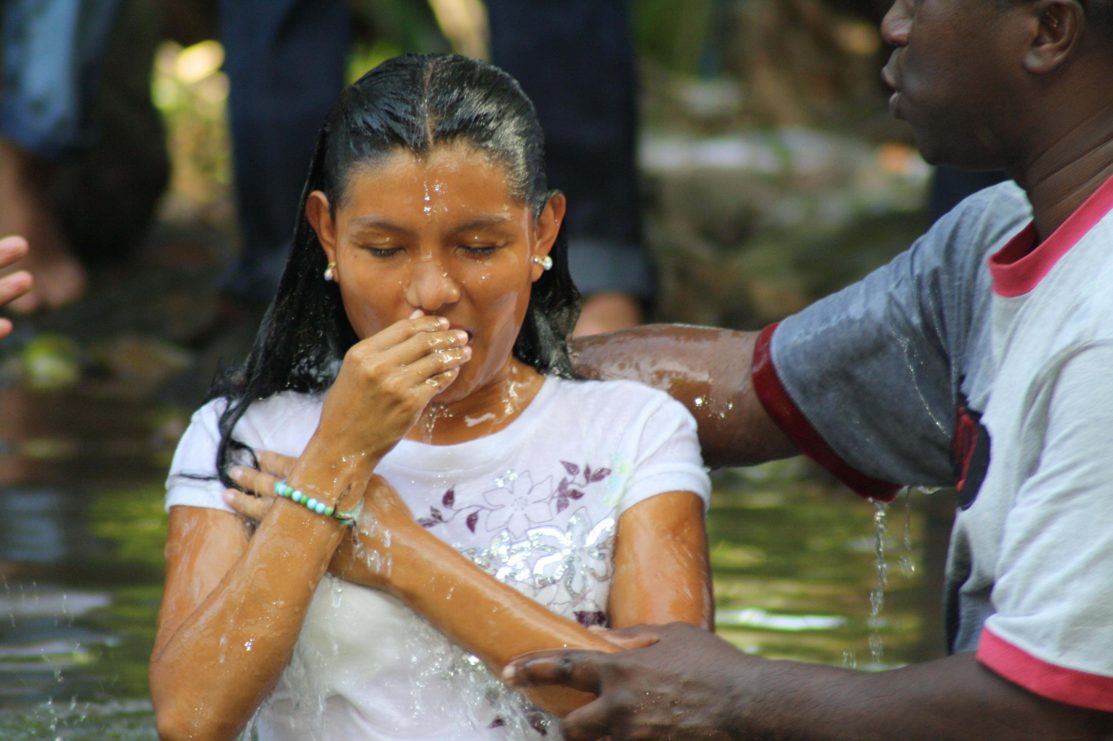
The Call Part three
Matt 28:19-20 baptizing them in the name of the Father and of the Son and of the Holy Spirit,

Slide 52
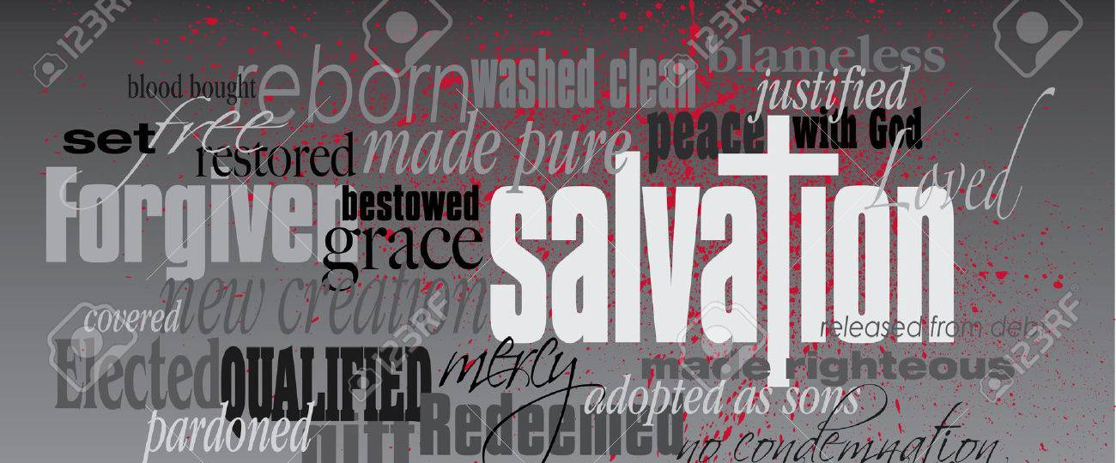
The Call – part four
Matt 28:19-20 teaching them to obey everything I have commanded you.

Slide 53
The Call – teach them
You are to be
Salt – Mt 5:13
Light – Mt 5:14
Sowing/seed - Mt 13:1-23
Fishing – Mt 4:19; Mk 1:17
Living – Ac 3:42-47; 4:32-35

Slide 54
The Call – Teach them
You are to -
Forgive
Be a neighbor
Love
Do Good
Etc.

Slide 55
The Call – teach them
Men
Women
Outcasts
Children
Foreigners

Slide 56
The Call – the action
What were they told?
Go – to all the world
Disciple – help them grow
Baptize – call for commitment
Teach – the words of the Lord

Slide 57
The Call – the destination
Acts 1:8 But you will receive power when the Holy Spirit comes on you; and you will be my witnesses in Jerusalem, and in all Judea and Samaria, and to the ends of the earth."

Slide 58
Reflection
Who do you think heard this command to go?
Just the 12
The 120 of the upper room
Over 500 men plus women and children

Slide 59
Reflection
How are you as individuals and a church doing at-
Going
Discipling
Baptizing
Teaching ????

Slide 60
Reflection
Pause
the Video

