Slide 1
Misiones Metropolitanos

Slide 2
Misiones Metropolitanos
Urban Rural
Individual group
Mixed uniform
Younger older
Education experience
Multileveled particular
Present to future past to present
Adaptive traditional
Technological relational
Enclosed space open space

Slide 3
Misiones Metropolitanos
Jesus
Rural Urban
Fishermen Pharisees
Farmers Priests
Crafts Scribes
Parables Philosophy
Peter Nicodemus

Slide 4
Misiones Metropolitanos
Jesus Focus
Visited the urban centers
Met people on the road
Forced to countryside
Final teaching Urban Setting

Slide 5
Misiones Metropolitanos
Paul’s ministry
Antioch
Philippi
Ephesus
Rome
Main focus was on urban ministry

Slide 6
Misiones Metropolitanos
Critical issues
Loss of identity
Loss of support
Loss of obligation
Loss of tradition
Loss of belonging

Slide 7
Misiones Metropolitanos
Critical issues
Loss of identity
Loss of support
Loss of obligation
Loss of tradition
Loss of belonging

Slide 8
Mixed social class

Slide 9
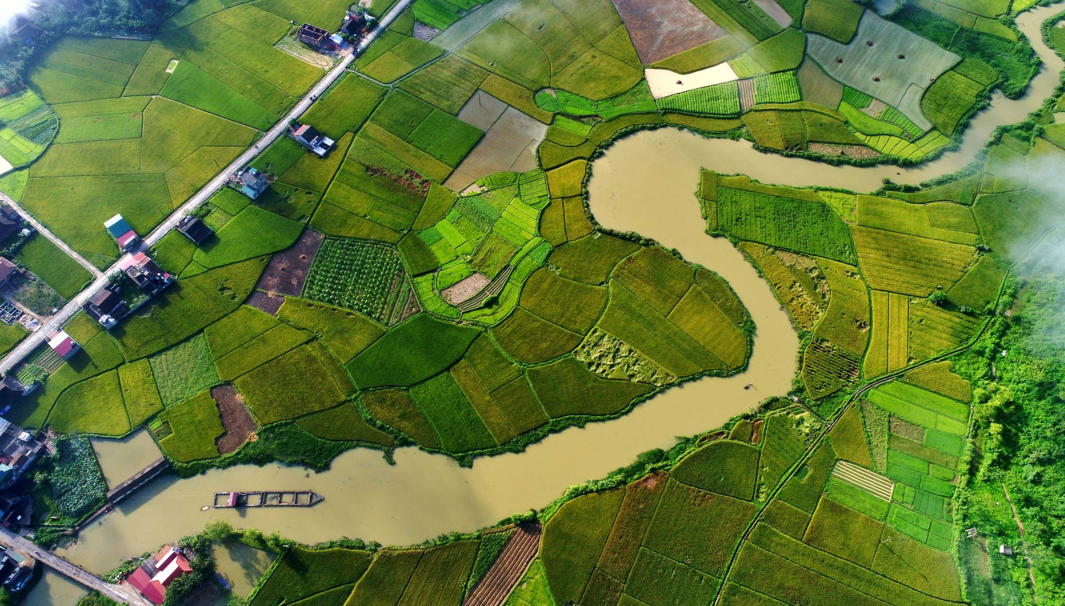
Rural culture

Slide 10
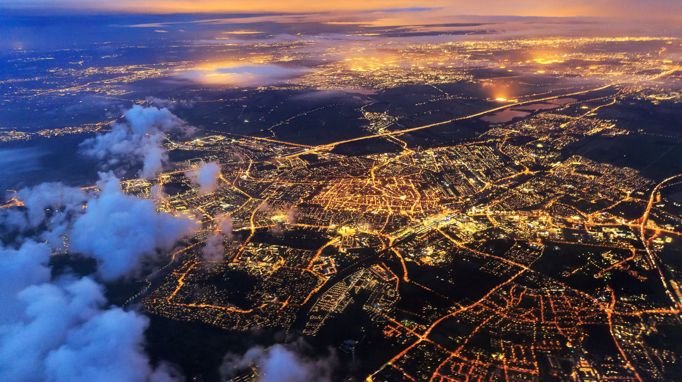
Urban culture

Slide 11
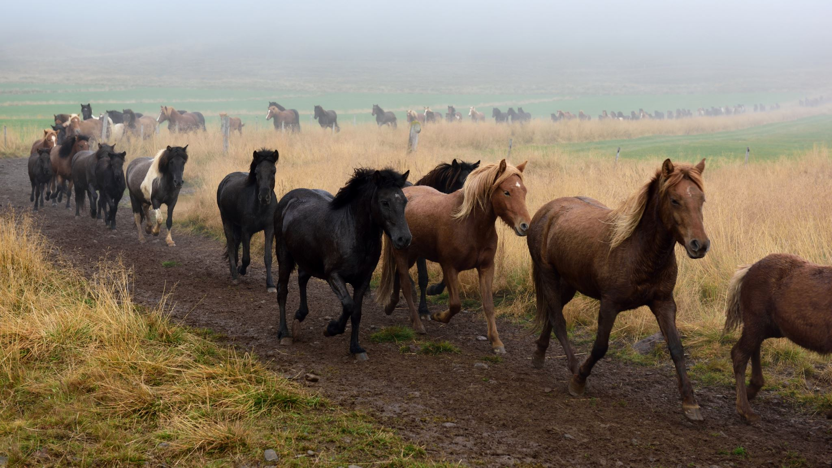
All Peoples

Slide 12
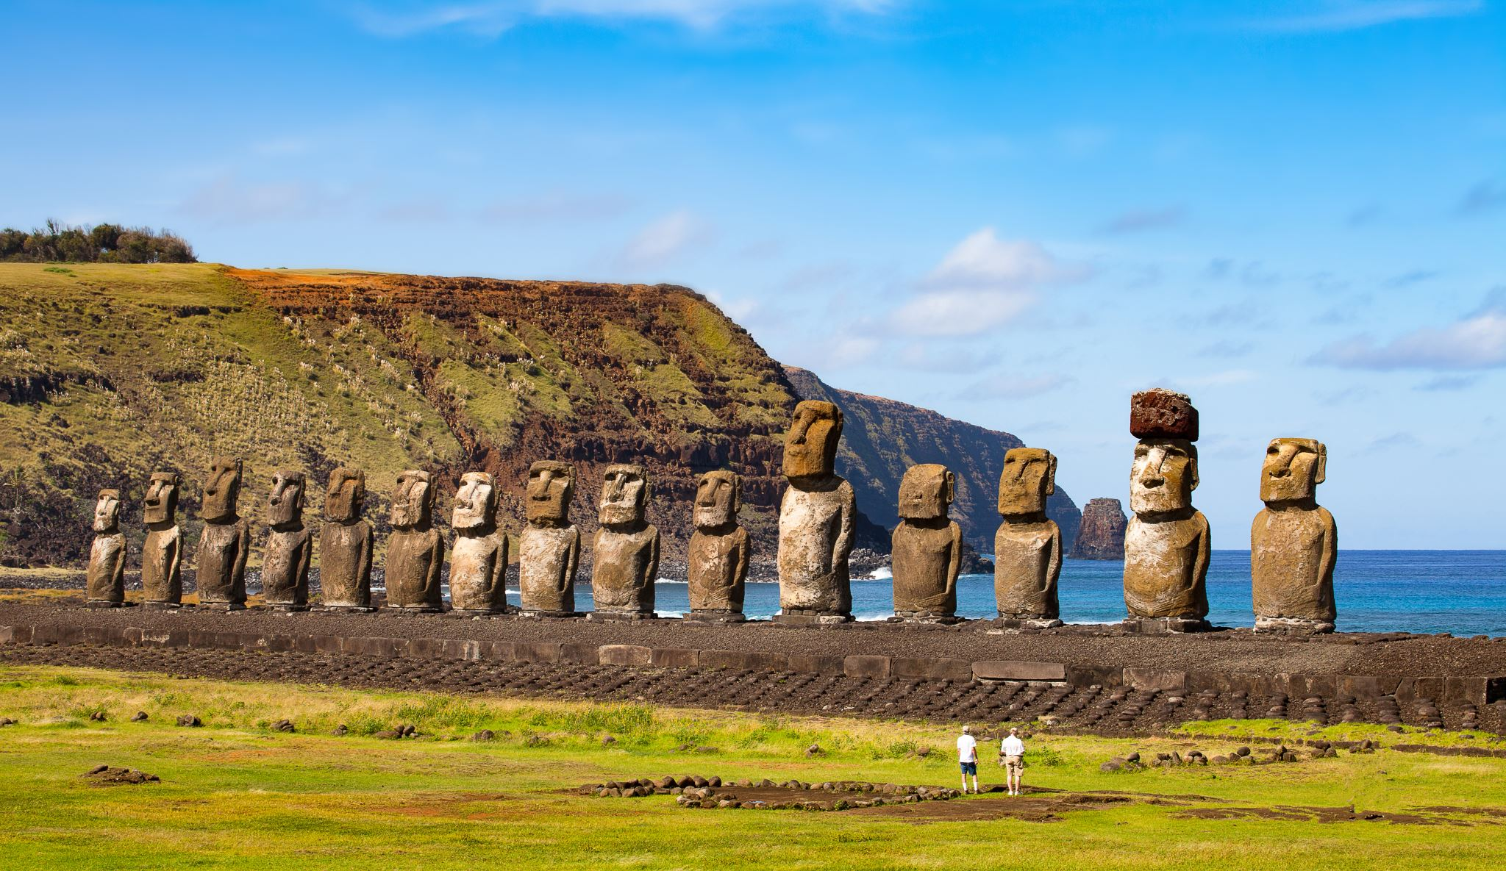
All Peoples

Slide 13
All Peoples
1 Co 9:22
I have become all things to all men so that by all possible means I might save some.

Slide 14
All Peoples
Gal 3:28-29
There is neither Jew nor Greek, slave nor free, male nor female, for you are all one in Christ Jesus.

Slide 15
All Peoples
Matthew/Luke – human genealogy
John – spiritual genealogy
Mark – Gospel of Jesus
John – Gospel of eternity

